Slide 2
1.Find the profit and sales for each subcategory of every type of product.
2. Which subcategory has highest profit in the year 2019.
3. In case 1, change the color of the view from the Marks card.
4. In the view, in the Sub-Category filter card, clear all of the check boxes except Bookcases, Machines, and Tables to have closer look on each value.
5. Find out the key insights about in which year bookcases and machines were profitable and unprofitable.
6. Show the sales region wise for every subcategory and category and every year.
7. Duplicate your worksheet and check sales region vise for Machine type subcategory.
8. In which region you are reporting a higher negative profit overall than in your other regions.
9. Show your view for Sales in the South for all subcategory.
10. Which subcategory has highest overall negative profit in the south region.
11. Take some decisions to improve profit in the south.
12. Rename your worksheet.
13. Save your workbook.

Slide 3
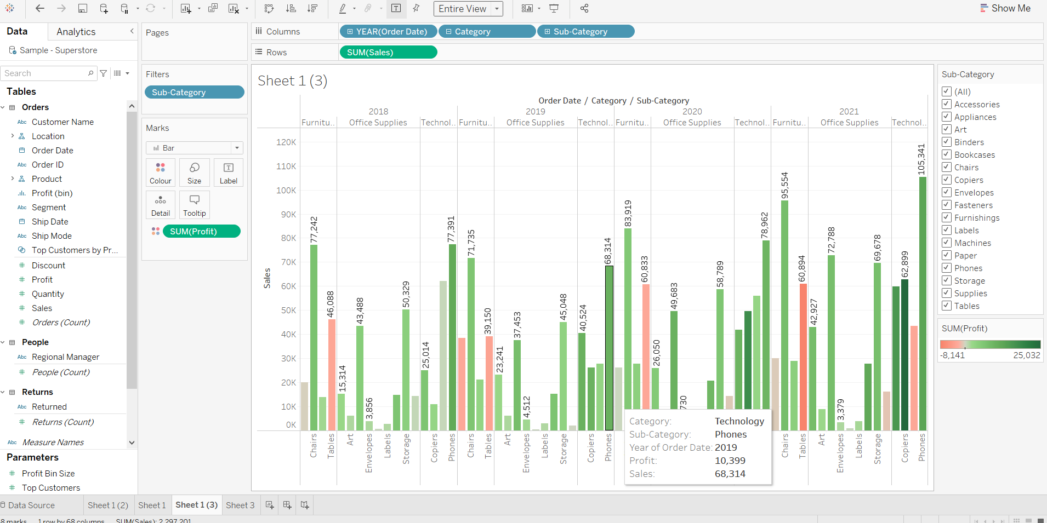
1.

Slide 4
2.
Phones
Profit =10,399

Slide 5
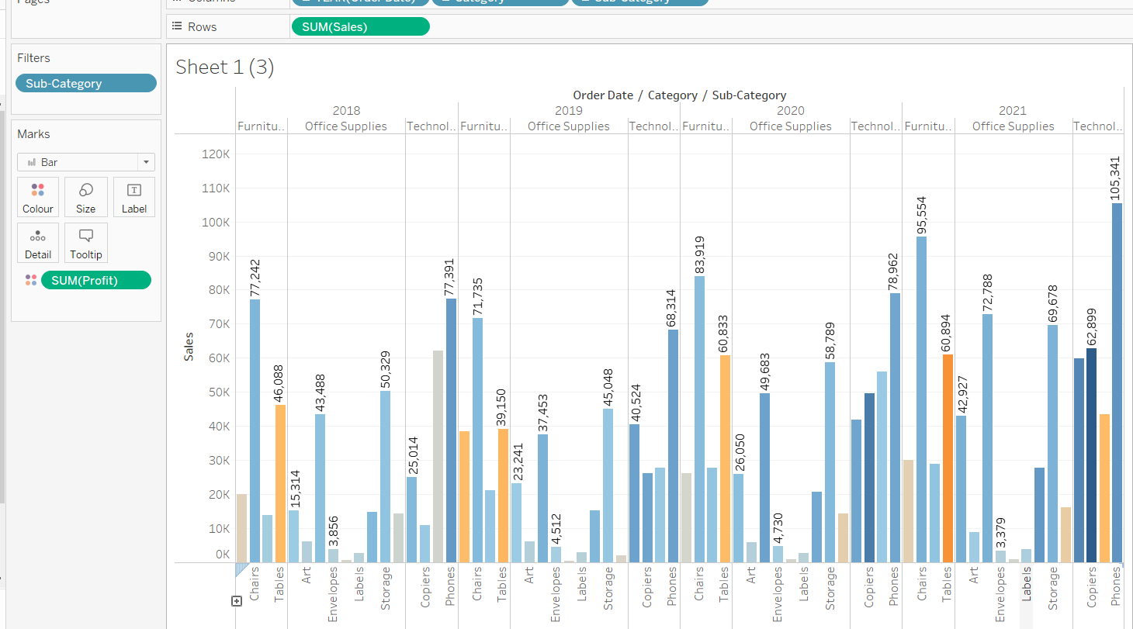
3.

Slide 6
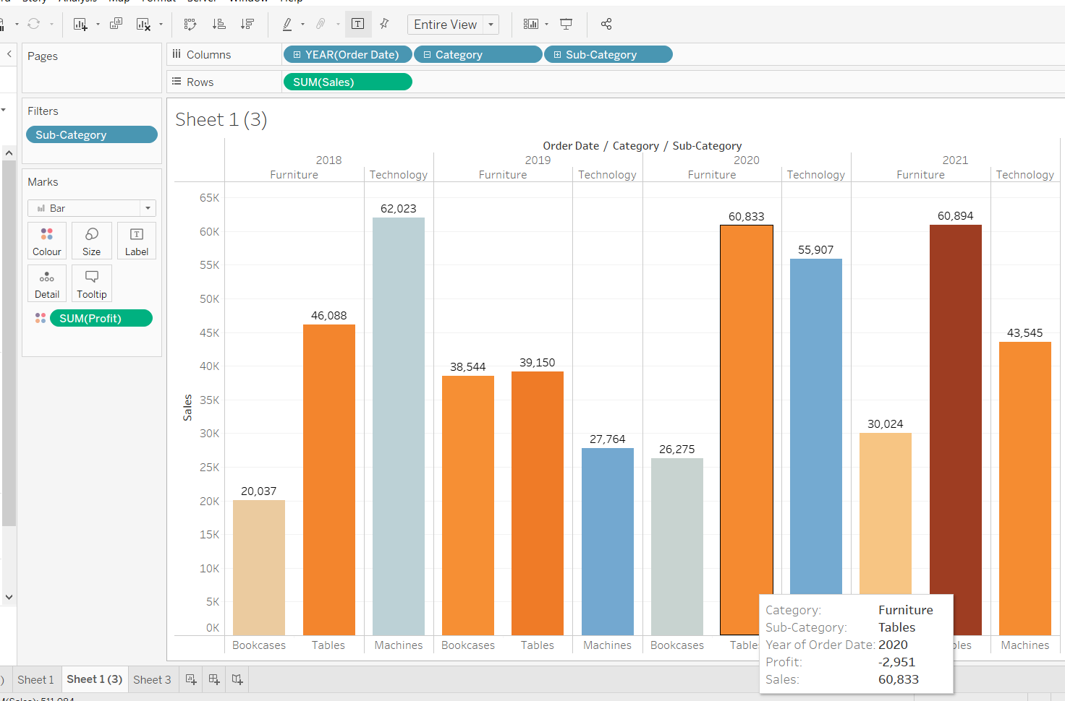
4.

Slide 7
5.
Year | Bookcases | Machines | Tables
2018 | -346 | 369 | -3120
2019 | -2755 | 2977 | -3510
2020 | -2951 | 2907 | -2951
2021 | -584 | -2869 | -8141

Slide 8
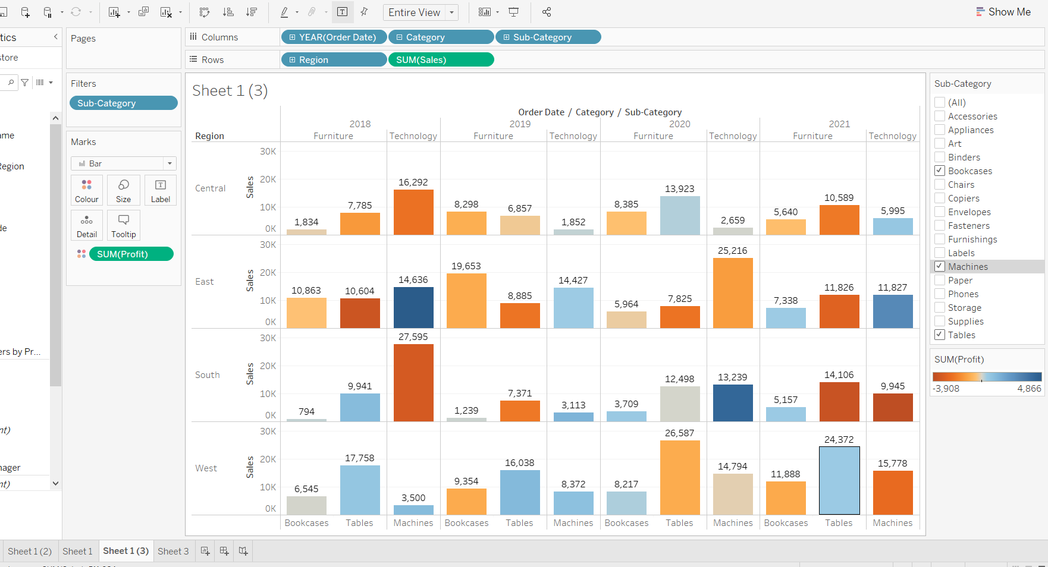
6.

Slide 9
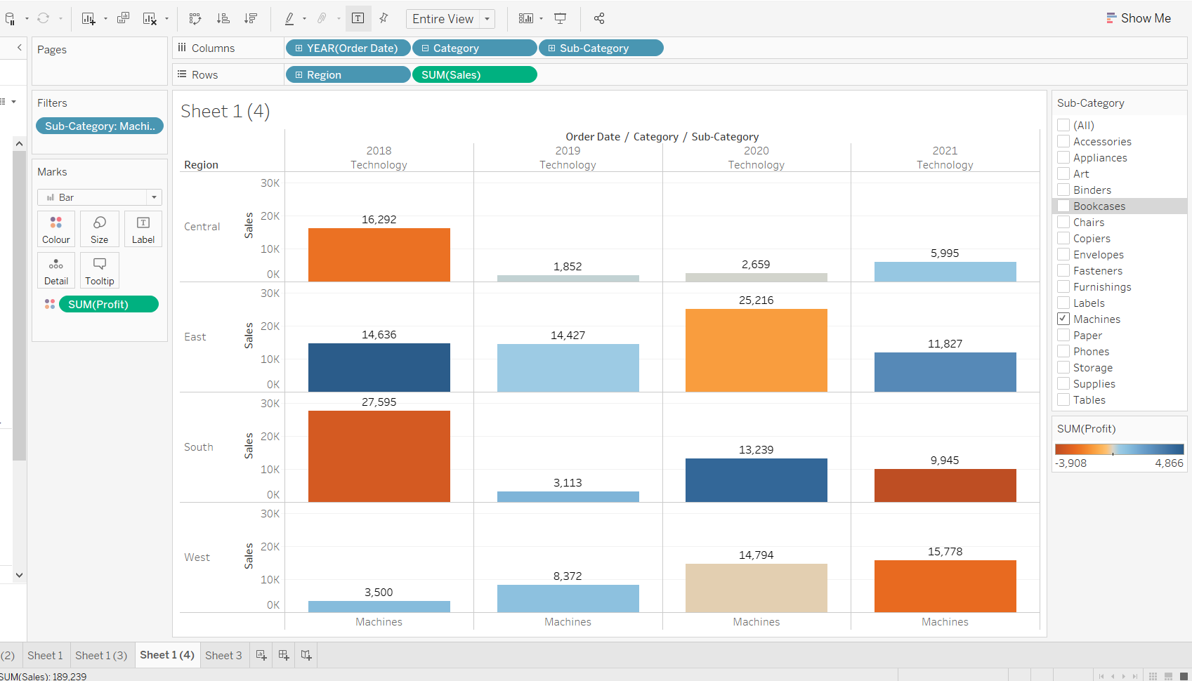
7.

Slide 10
8.
In the south, with 2 red bars

Slide 11
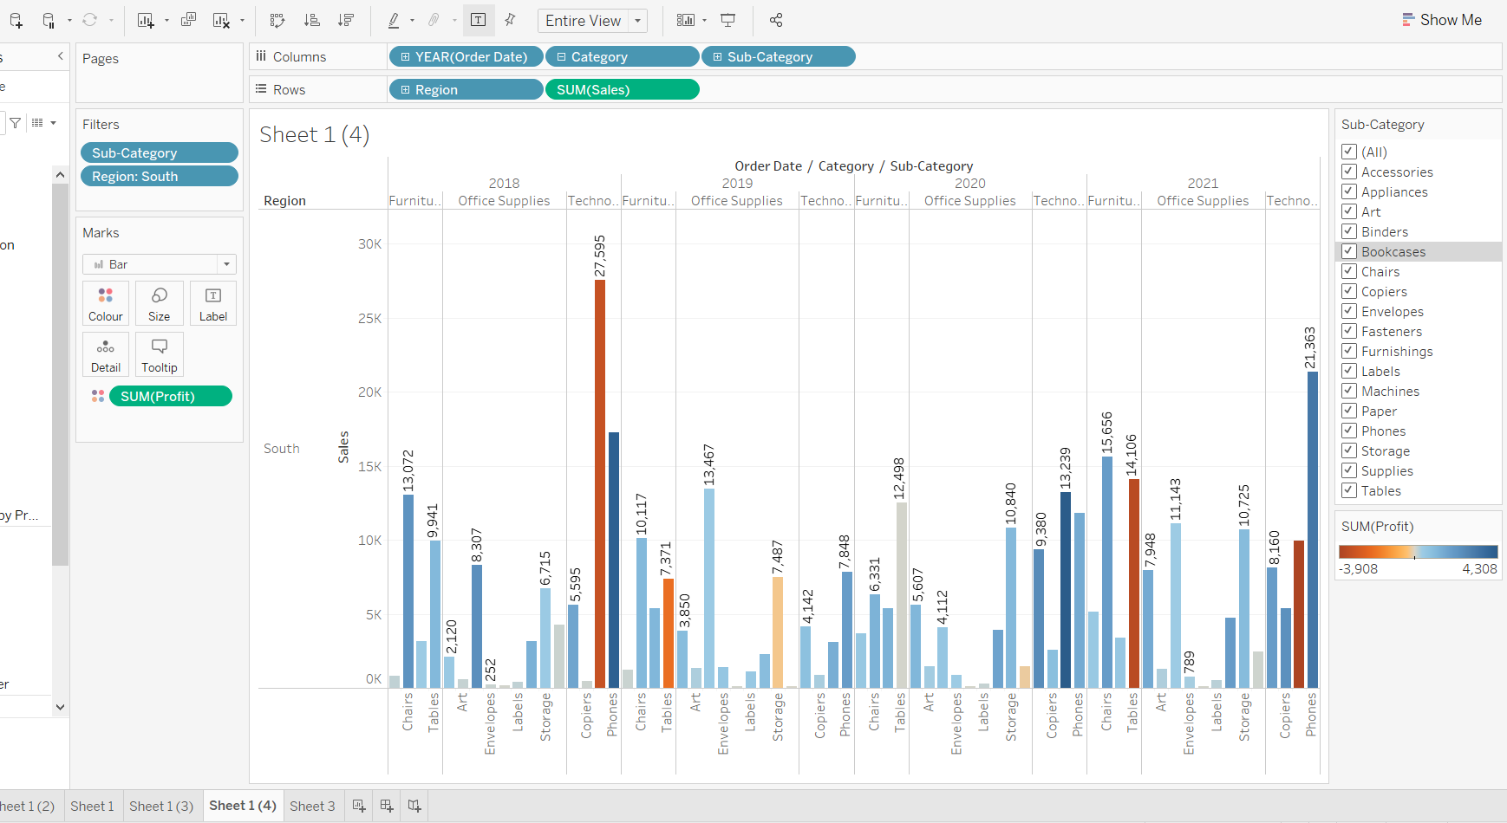
9.

Slide 12
10) Machines (27955) with a negative profit of 3254
11) We can see that most of the loss is accured from the sector of office supplies and furniture. So, we need to go through their processes once again so that we could slack off some production budget from them.
Also , Machines showed the loss in the year of 2018 and 2021 which were the highest losses of all time. So, maybe we need to limit the no. of machines we make in order to suffer less negative profit.
12) Rename
13) save

